Slide 1

Concurrency: Reactive vs Shared State
Benchmarking Akka actors against shared-state concurrency
June 17th, 2015

Slide 2

ABOUT ME | DANA PEELE, SR APPLICATION DEVELOPER
Developer
Rock climber
Dad
Scala junkie

Slide 3




Four E-commerce banners
NOT an agency
Strong engineering culture
Incredible stacks
Scala/Play/Akka/Mongo
Node/React/Ember

Slide 4
Concurrency
Multiple threads executing simultaneously
Our example- an inventory web service with multiple clients making requests in parallel
Challenge- ensure that we don’t sell inventory we don’t have
Inventory Web Service

Slide 5
Options to Handle Concurrency
Shared-State
Akka (Reactive)
Other:
Function Reactive Programming (Not the same as Reactive)
Publisher/Subscriber

Slide 6
Shared-State
Shares mutable state across threads
Uses locks to prevent race conditions
Pros
Heavily used
Simple to reason about for trivial applications
Cons
Thread sleep/awake is expensive
Complex applications are very difficult to model
Deadlocks!

Slide 7
Akka (Reactive)
Actors instead of threads- lightweight, easy to reason about
Actors communicate with message passing
Messages are objects containing information
Not imperative, they provide information and are REACTED to by the actor.
Ex “Someone requested 5 shirts”, not “Give me 5 shirts”
Mutable state- But only an actor can change itself
Each actor has a mailbox (queue)- synchronous message processing

Slide 8
Akka (Can you tell we like this?)
Pros
No locks! So no thread sleep
Ability to use pools for actions that don’t modify state
Completely non-blocking communication between actors
Modeling mimics real life: actor has one job and does one task at a time
Delegation- delegate tasks to children to allow for concurrent processing, fault tolerance, etc
Supervision- parent handles faults in child (can restart, stop, resume, etc)
Very loose coupling, messages are strongly typed, methods aren’t
Functional: new functions are new actors, robust and easy to test
Cons
Design is extremely important
Resiliency, parallel processing, and supervision depend on this design
Lack of typing for actor receive method (which handles all messages)
So a message can be any object- scary for Java guys
Single threading for mutable state, challenging to multithread in this case
Solved with sharding (actor per id), not with multiple writers

Slide 9
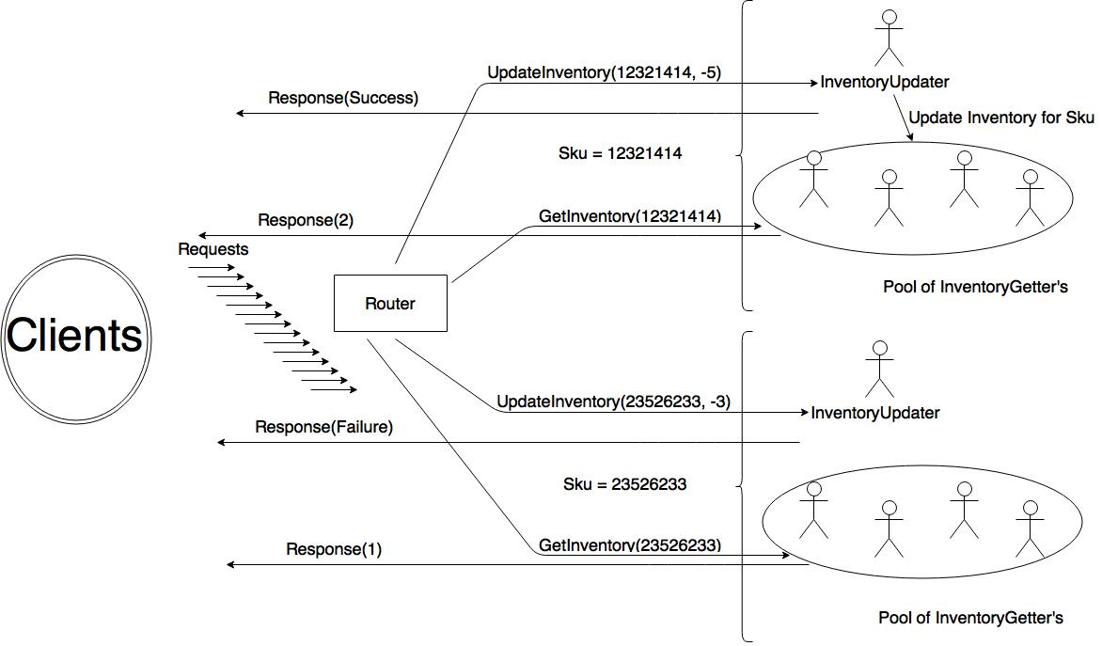
Notes:
There are 7 of top sku. We send a request for 5 of this sku. This message is routed to the InventoryUpdater actor for this sku. We receive success response from InventoryUpdater. It updates it’s internal state to 2 and it sends update inventory message to each of the pool of InventoryGetters for this sku to update their internal state to 2 as well. A request for the current inventory of the top sku is made. It is routed to one of the InventoryGetters which returns a response of 2.
There is 1 of bottom sku. We send a request for 3 of this sku. This message is routed to the InventoryUpdater actor for this sku. We receive failure response from InventoryUpdater. A request for the current inventory of the bottom sku is made. It is routed to one of the InventoryGetters which returns a response of 1.

Slide 10
More Akka Information(!!!)
Extremely High Performance:
50 million messages/second on a single machine
Small Memory Footprint:
2.5 million actors per GB of heap
Hierarchical:
All actors have parent and 0-n children
Extended by powerful frameworks
Spray (Rest), Play (Web apps), Slick (DB), Streams

Slide 11
Other Concurrency Strategies
Functional Reactive Programming
Instead of messages or events, a signal is continually emitted which represents a value over time
Signals are aggregated to form new signals
Con: Not good for two way communication or state which can be concurrently modified
Publisher/Subscriber
Javascript event handling for example
Listeners register a handler with an event source
Cons
Forces imperative style
Concurrency gets very complicated (callback hell)
Tightly coupled code

Slide 12
DevOps
At HBC we are using
Kitchen (testing)
Vagrant (virtual machines)
Puppet (provisioning)
Librarian Puppet (more provisioning)
Docker (containers)
We practice Infrastructure as code
versioning
pull requests
code review
regression testing
reproducibility
Linux base box
Puppet Librarian
to source modules for SBT, Java, MongoDB, and Docker
Installed in my base box (provision)
spin up and deploy a Docker container running StatsD and Graphite
Run Play applications with SBT and Java while running MongoDB, StatsD, and Graphite instances ready to use.
Notes:
Right column is Dev Ops used in this demo. Now let’s look at code!!!

Slide 13
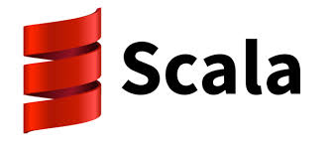



Q&A

Slide 14
Obligatory We Are Hiring Slide
Surprise! We are hiring.
Follow us:
Twitter: @HBCDigital
LinkedIn: https://www.linkedin.com/company/hbc_digital?trk=biz-companies-cym
Contact Info:
dana_peele@s5a.com
@Dana_S_Peele
Repo for the demo and slideshow:
https://github.com/saksdirect/react-vs-shared-state-inventory

